Slide 1
ReCom: An Efficient Resistive Accelerator for Compressed Deep Neural Networks
Houxiang Ji*, Linghao Song$, Li Jiang*, Hai(Halen) Li$, Yiran Chen$
*CSE Dept, Shanghai Jiao Tong University, Shanghai, China
$ECE Dept, Duke University, Durham NC, U.S.A

Slide 2
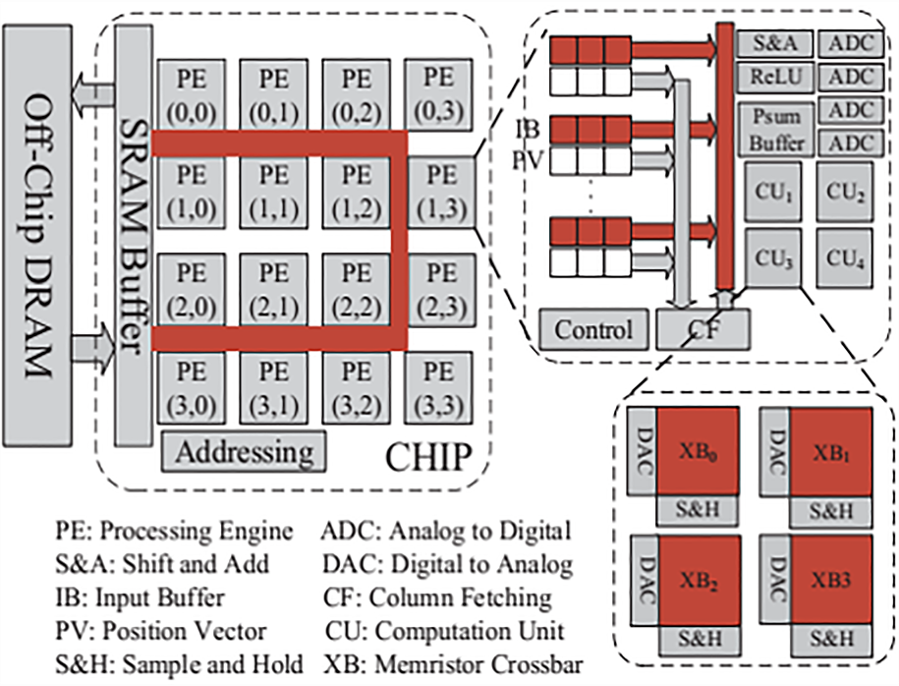
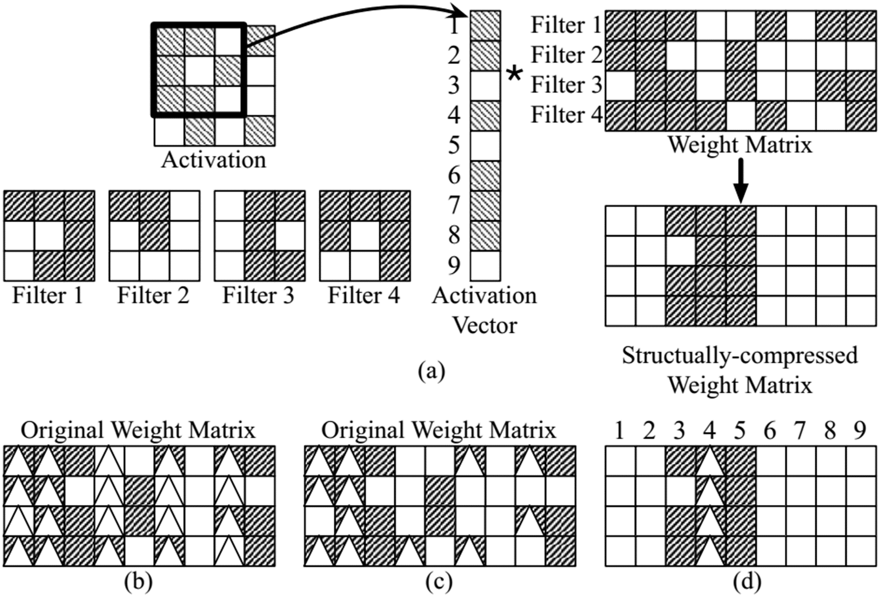
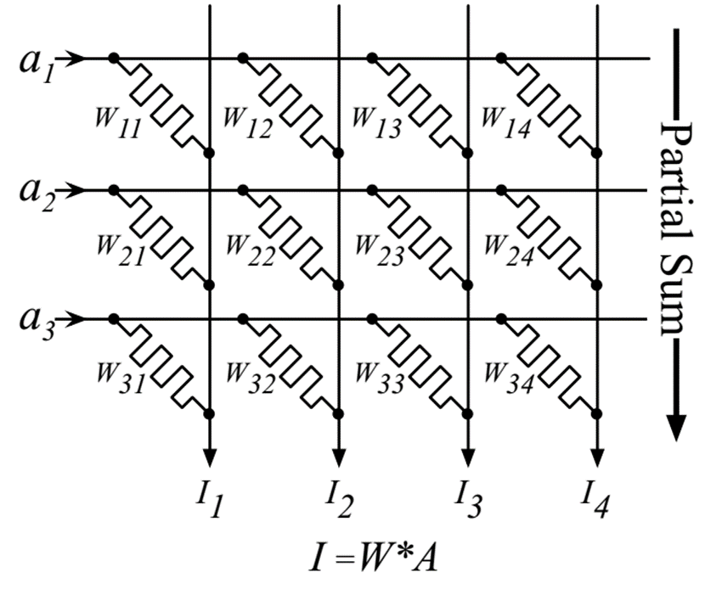
ReCom
Sparse Neural Network Acceleration with ReRAM
Theoretical Speedup ≠ Practical Speedup
Structural Compression
Speedup up to 10.66x
Energy saving up to 9.43x

